Slide 1
FBLA Judging

Slide 2
Why Would I Want to Judge FBLA?

Slide 3

Community Service Credits
Enjoyable community service project
You get to meet new teenagers
Not a difficult community service project
There is a wide range of different events to possibly judge.

Slide 4

Good Public Relations
Helps you and the company you work for show you care about the community
The people you meet could be new costumers
Build connections to the education system

Slide 5
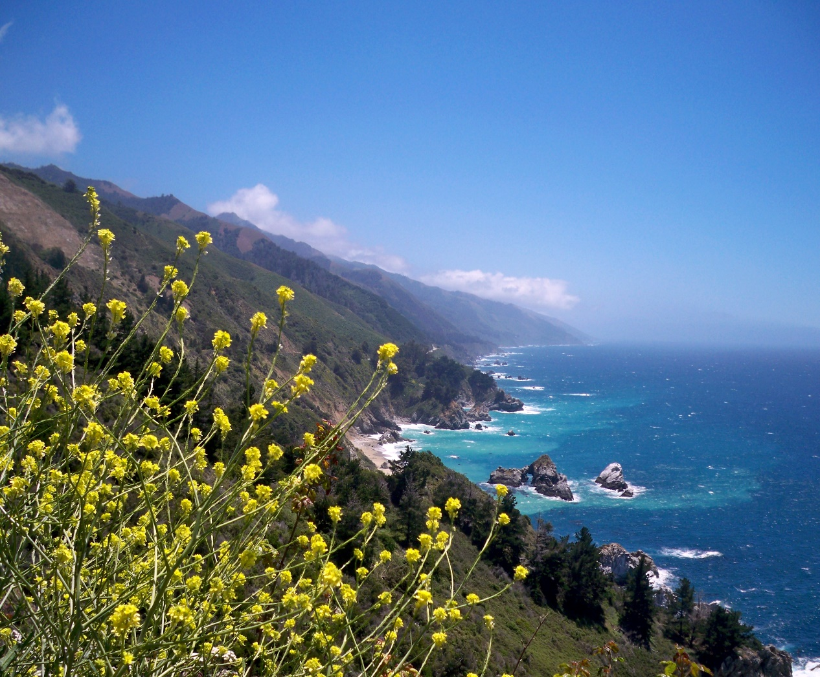
Travel
You may get to travel to somewhere you have never been to before
Lunch will be paid for
Lots of the time spent in California will be spent as a vacation

Slide 6
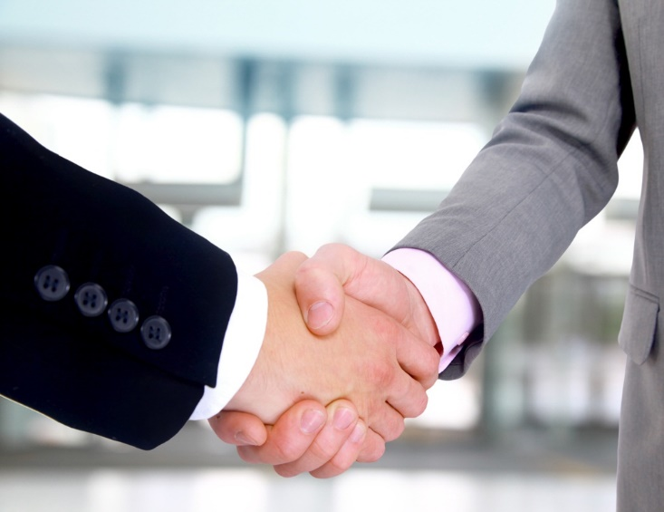
Teenage Employees
You may be looking to hire a teenage employee
It is the perfect time to see if a teenager would take the job seriously or not.

Slide 7

Learning
You may learn something new and valuable
What you learn could be used for your own company

Slide 8
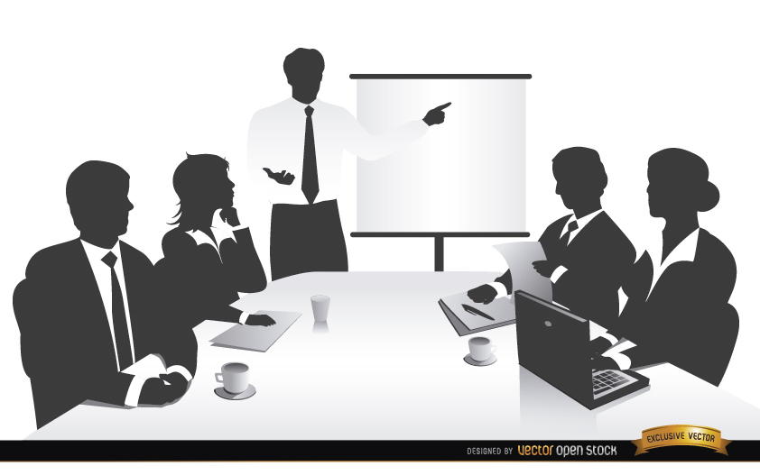
Role Model
You get a chance to be a positive role model specifically towards teenagers
You also can affect the business world in the near future
Provide your own perspective
Give constructive criticism
Help students improve upon themselves

